Slide 1



Step it up – Marketing the
Wales Coast Path:
Writing a promotional newsletter

Slide 2
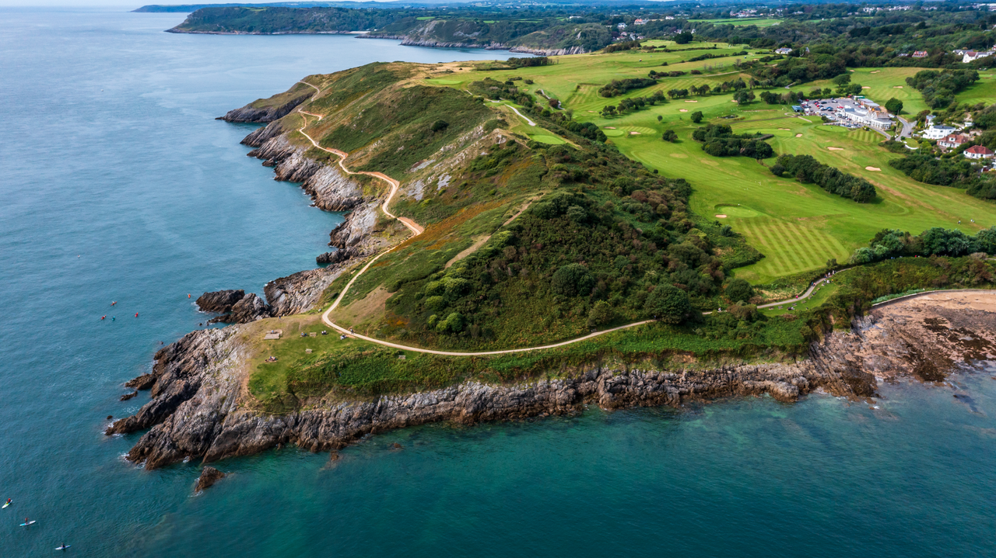

Background - What is the Wales Coast Path?
Step it up – Marketing the Wales Coast Path – Writing a promotional newsletter
An 870-mile-long continuous coastal footpath which stretches along the entire length of the Welsh coastline.
The whole path is accessible to walkers, with some sections suitable for cyclists, families with pushchairs, people with restricted mobility, and horse riders.

Slide 3
What is marketing?
Step it up – Marketing the Wales Coast Path – Writing a promotional newsletter
Working in small groups, discuss and write down:
• What to do you understand by the term ‘marketing’?
• What does marketing do?
• Why do people use marketing?
• Who uses marketing? Can you think of any companies or organisations that market their products?
• When do things get marketed?
• What are the pros and cons of marketing for an organisation?

Slide 4

What is marketing?
Step it up – Marketing the Wales Coast Path – Writing a promotional newsletter
Marketing is about making sure the right people know about what you have to offer, getting them to come to you and getting them to buy or buy into what you have to offer.

Slide 5

Your brief
Step it up – Marketing the Wales Coast Path – Writing a promotional newsletter
Imagine you are marketing experts.
Your client Natural Resources Wales (NRW),
would like your help to plan and create a promotional newsletter for the Wales Coast Path.
Your newsletter will be emailed to people across Wales with the aim of encouraging tourists to visit and discover the Wales Coast Path.

Slide 6
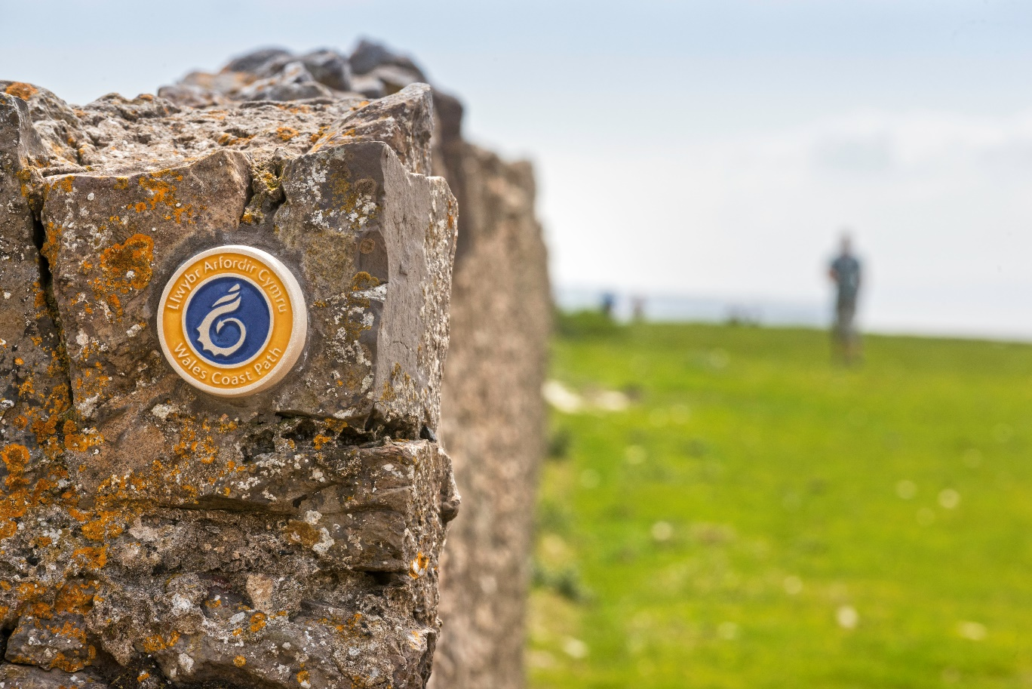
Task
Step it up – Marketing the Wales Coast Path – Writing a promotional newsletter
Working in small groups:
Consider, is there a section of the path your group would like to promote?
Or will you create a newsletter to promote the Wales Coast Path in general?

Slide 7

Discuss: What are the pros and cons of a promotional newsletter?
Step it up – Marketing the Wales Coast Path – Writing a promotional newsletter

Slide 8

Background information
Step it up – Marketing the Wales Coast Path – Writing a promotional newsletter
What do you know about the client?
Understanding your client’s business is critical to ensuring the success of your marketing campaign.
What does your group know about Natural Resources Wales?
What does the organisation do?
How many staff does the organisation employ?
What are its roles and responsibilities?
What is its role in the Wales Coast path?
Click the icon to watch a short video about what NRW does

Slide 9
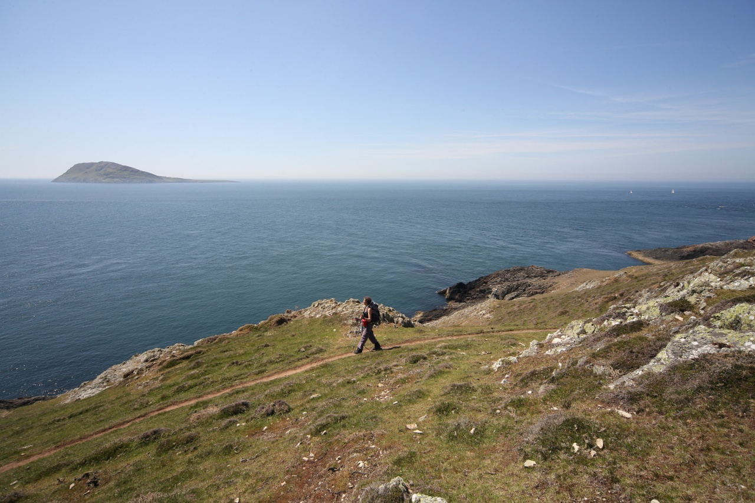
What do you know about the Wales Coast Path?
Step it up – Marketing the Wales Coast Path – Writing a promotional newsletter
Complete some research into the history and significance of your chosen section of the Wales Coast Path.

Slide 10
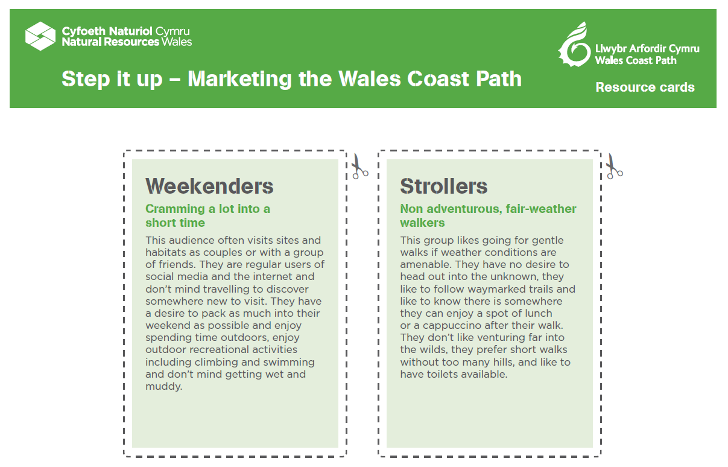
Identify who’s the target audience?
Step it up – Marketing the Wales Coast Path – Writing a promotional newsletter
A target audience is the specific group of people you want to reach with your marketing materials. They are the people who are most likely to be interested in your content.

Slide 11
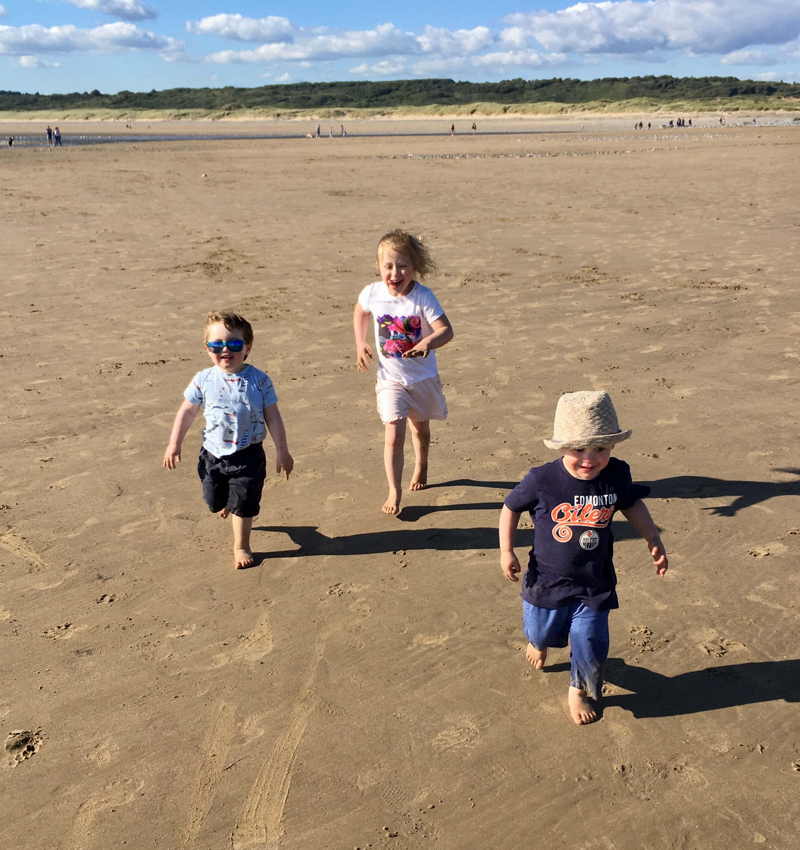
If you are visiting the Wales Coast Path…
Step it up – Marketing the Wales Coast Path – Writing a promotional newsletter
…there may be opportunities to carry out some market research and on-site investigations
What are your first impressions of the Wales Coast Path? Note your observations.
Can you create a word cloud to capture the unique selling points of the Path?
Can you prepare a questionnaire to get insights into why people visit the Path?

Slide 12
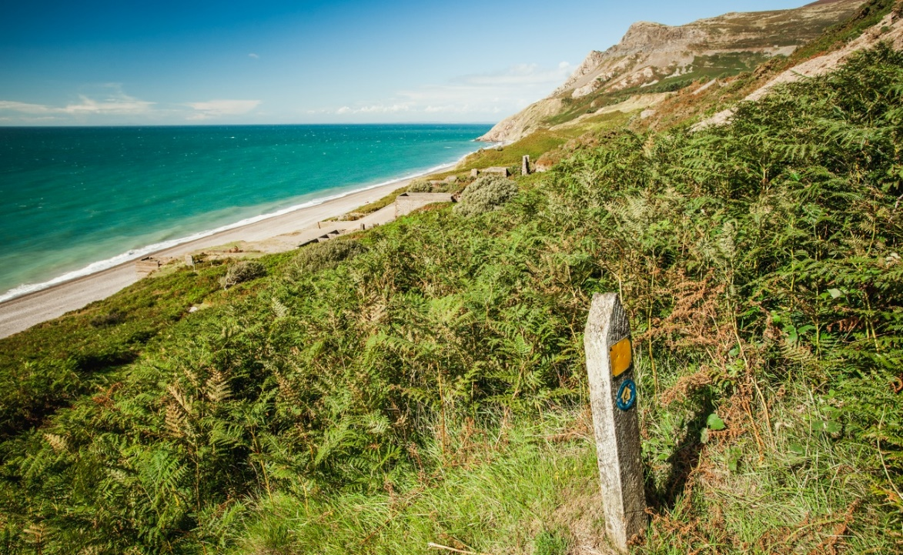
If you are visiting the Wales Coast Path…
Step it up – Marketing the Wales Coast Path – Writing a promotional newsletter
…there may be opportunities to carry out some market research and on-site investigations
Create a simple data collection sheet to record the number of users visiting the given stretch of path.
Take photos – these might feature in your newsletter!

Slide 13
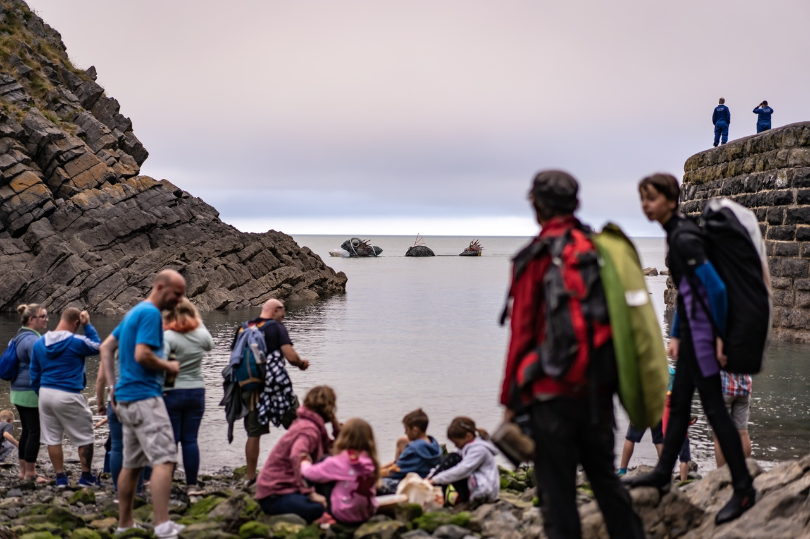
Planning and sharing ideas for your promotional newsletter
Step it up – Marketing the Wales Coast Path – Writing a promotional newsletter
What are the unique selling points of your chosen section of the Wales Coast Path?
People who work in the marketing industry talk about the Unique Selling Point (USP) – the thing which makes their offer different and/or better than others.
What are the unique selling points of the Wales Coast Path that you want to promote to your target audience? Note your ideas.
How will you communicate them?

Slide 14

Sharing your initial ideas with the client
Step it up – Marketing the Wales Coast Path – Writing a promotional newsletter
Get feedback and approval from the client before pressing ahead with your ideas.
Your could pitch your ideas to the ‘client’ in the form of a:
• Group presentation – using Microsoft PowerPoint or Google Slides.
• Two-minute group talk – explaining your main ideas and thoughts on the direction the promotional newsletter should take.
• Create a mood board - A mood board is a digital or physical, pictorial collage of ideas.

Slide 15

Set SMART objectives for the writing of your promotional newsletter
Step it up – Marketing the Wales Coast Path – Writing a promotional newsletter
Make sure your objectives are:
    S – Specific
    M – Measurable
    A – Achievable
    R – Relevant
    T – Time bound

Slide 16
Set SMART objectives for the writing of your promotional newsletter
Step it up – Marketing the Wales Coast Path – Writing a promotional newsletter
Make sure your objectives are:
S – Specific e.g. We want to create a promotional newsletter to raise awareness of the wildlife along the Wales Coast Path.
M – Measurable e.g. we want to increase the number of visitors to the Wales Coast Path by 5%.
A – Achievable There’s no point trying to increase the number of visitors to the Wales Coast Path by 2 million people if you only have 3 weeks to achieve this. Although it’s a great aim, it would be very hard to achieve.

Slide 17
Set SMART objectives for the writing of your promotional newsletter
Step it up – Marketing the Wales Coast Path – Writing a promotional newsletter
Make sure your objectives are:
R – Relevant The whole purpose of your promotional newsletter is to increase awareness and use of the Wales Coast Path. If your plan ends up raising awareness of a new garage that has opened in the area, then it’s not relevant!
T – Time bound Is what you plan to write about in your newsletter feasible in the time you have available? Set deadlines to complete tasks by, this will help you prioritise and reduce the risk of you becoming overwhelmed.

Slide 18

Risks/Challenges
Step it up – Marketing the Wales Coast Path – Writing a promotional newsletter
Planning and creating a promotional newsletter may not appear to involve much risk, but thinking about risk is integral to communication.
Consider:
What could go wrong when you send out your promotional newsletter?
2. What is the likelihood and impact of something going wrong?
3. What can you do to minimise the risk?

Slide 19
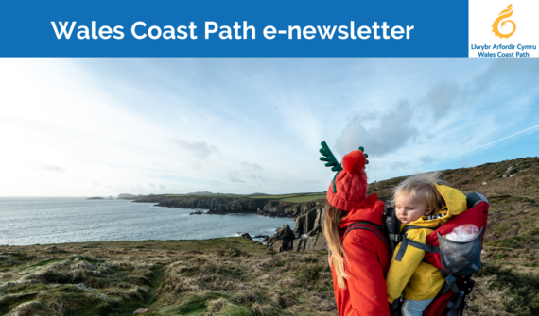
Writing your Wales Coast Path promotional newsletter
Step it up – Marketing the Wales Coast Path – Writing a promotional newsletter
Newsletters:
Are an easy way to keep in touch with loyal or prospective Wales Coast Path visitors
Can use a storytelling format

Slide 20

Create a simple template for your newsletter
Step it up – Marketing the Wales Coast Path – Writing a promotional newsletter

Slide 21

What lessons can you learn?
Step it up – Marketing the Wales Coast Path – Writing a promotional newsletter
As a group, look at a range of promotional newsletters and scrutinise them.
What are the pros and cons of each newsletter?
What lessons learnt can you carry over to your own newsletter?

Slide 22
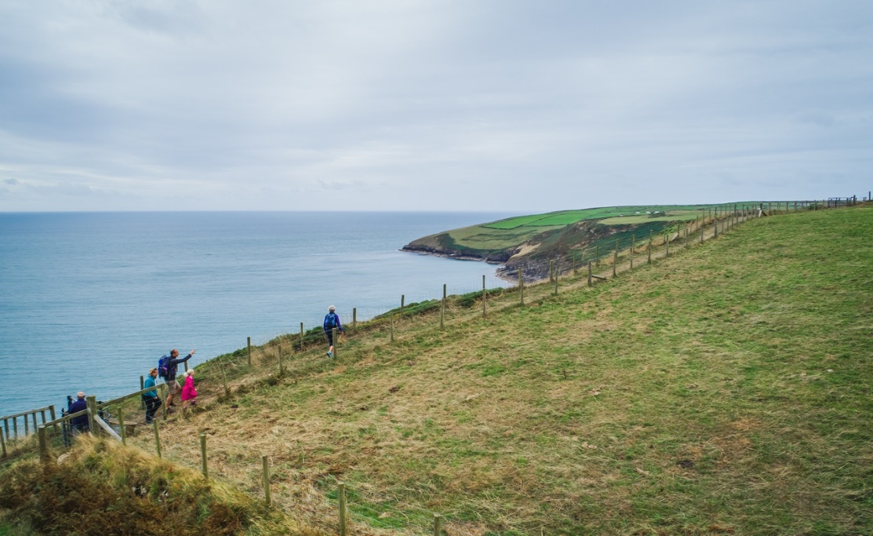
What does your newsletter need to include?
Step it up – Marketing the Wales Coast Path – Writing a promotional newsletter
Introduction?
The story?
Route map?
Distance information?
Location map?
Details of facilities?
Photographs?
Contact information?

Slide 23

What do readers want to know about?
Step it up – Marketing the Wales Coast Path – Writing a promotional newsletter
Wildlife sightings – how are certain species faring along the path
New services or facilities – new water refill stations, remedial work
New members of staff or volunteers
Upcoming events
Relevant info - What to see in spring at xxxx
Useful info - Bus times and routes
Conservation work – what’s being done and why
Encourage subscribers to get involved – share pictures of wildlife, complete a survey
Special offer – free cup of tea for readers, taking a selfie

Slide 24

When writing your newsletter make sure to be:
Step it up – Marketing the Wales Coast Path – Writing a promotional newsletter
Interesting and relevant
Imagine you are your reader and you know nothing about the Wales Coast Path. Ask yourself “Would I be interested in reading this?”
Short and snappy
People tend to have a shorter attention span. Keep your text concise and to the point.
Clean and simple
Less is more. It’s ok to have some blank space.

Slide 25


When writing your newsletter make sure:
Step it up – Marketing the Wales Coast Path – Writing a promotional newsletter
Your newsletter won’t distress your reader’s retinas
Your leaflet needs to look professional and shouldn’t be a shower of colour. Stick to 3 to 5 colours in your colour palette.
Your newsletter tells the story and communicates the unique selling points
Remind readers of the unique selling points of the Wales Coast Path, the things which make it different and better than other paths. Positive language is required, try and create a memorable impact.

Slide 26
When writing your newsletter make sure:
Step it up – Marketing the Wales Coast Path – Writing a promotional newsletter
It doesn’t have a specific date
It needs to stand the test of time. Displaying a specific date, will date the leaflet.
You make effective use of subheadings
Effective subheadings can draw the reader into the full text or help them find the most important points.
Visit the Wales Coast Path
Where is the best place to park?
Where can you get a cup of tea?

Slide 27
When writing your newsletter make sure:
Step it up – Marketing the Wales Coast Path – Writing a promotional newsletter
You use the right tone of voice
Writing voice and tone matter. Keep it simple, use straightforward language with no jargon, slang or acronyms. You are speaking directly to your audience. Use positive language, adopt an active voice and write in the second person.
The text is readable
Don’t be tempted to go for a smaller font to cram more text in – people need to be able to read what you’ve written.
The leaflet is branded and includes relevant logos
Who’s been involved? Acknowledges partners. Do any logos need to be included?

Slide 28

When writing your newsletter make sure:
Step it up – Marketing the Wales Coast Path – Writing a promotional newsletter
You make it easy for users to get in touch
How do users get in touch if they want to find out more?
Include a call to action
After reading the newsletter, what do you want the reader to do? Let the audience know: ‘Book today!’, ‘Refill here’ or ‘Visit soon!’

Slide 29
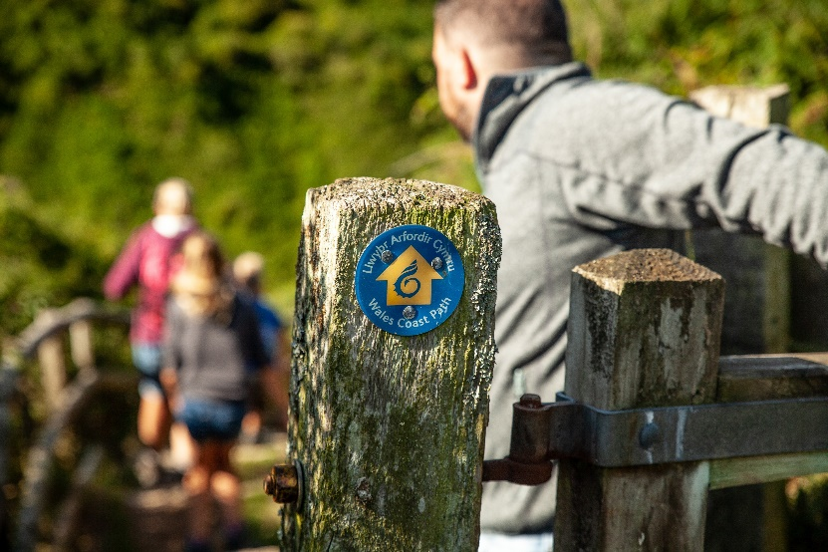
Choosing the right images
Step it up – Marketing the Wales Coast Path – Writing a promotional newsletter
When choosing images for your newsletter consider:
Do the images help the user understand the point you are trying to make?
Do the images speak to your target audience? For example, if targeting families, a picture of a family out walking will be best.
Do the images create emotional appeal? Do they encourage the reader to visit the site and walk along the beach for themselves?
High-res images are a must!

Slide 30
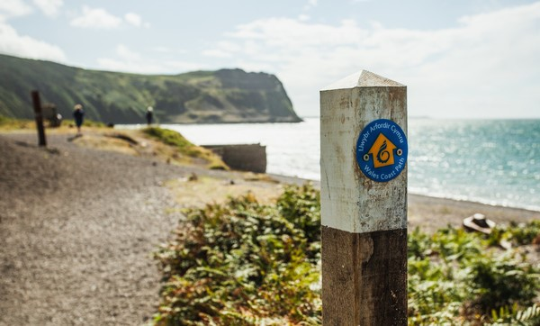
Identifying success
Step it up – Marketing the Wales Coast Path – Writing a promotional newsletter
How will your know if your newsletter has made an impact and if you’ve met the ‘client’s’ brief?

Slide 31
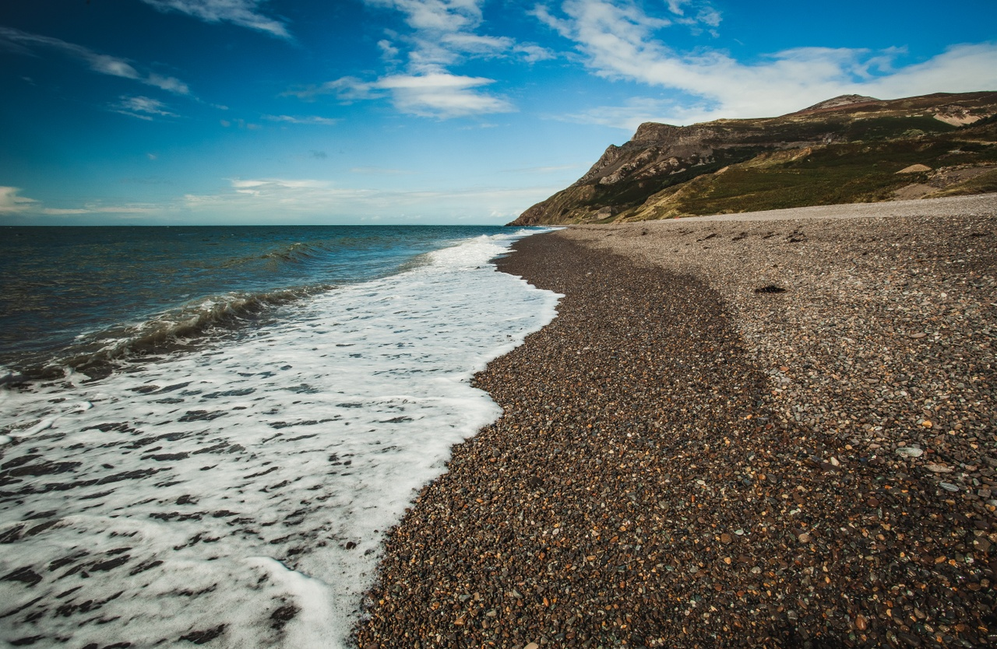
Lessons learnt
Step it up – Marketing the Wales Coast Path – Writing a promotional newsletter
What were your group’s successes and weaknesses?
What steps can you take next time to ensure things go more smoothly?

